Slide 1
Internet of Things
Instructor: Subhadeep Dash
Project Manual

Slide 2
Installing Arduino IDE for NodeMCU and Arduino
1
Let’s start with the first set of slides

Slide 3
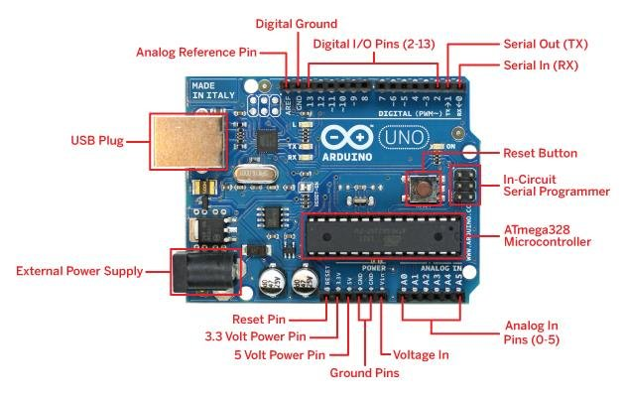
Parts of Arduino Uno

Slide 4
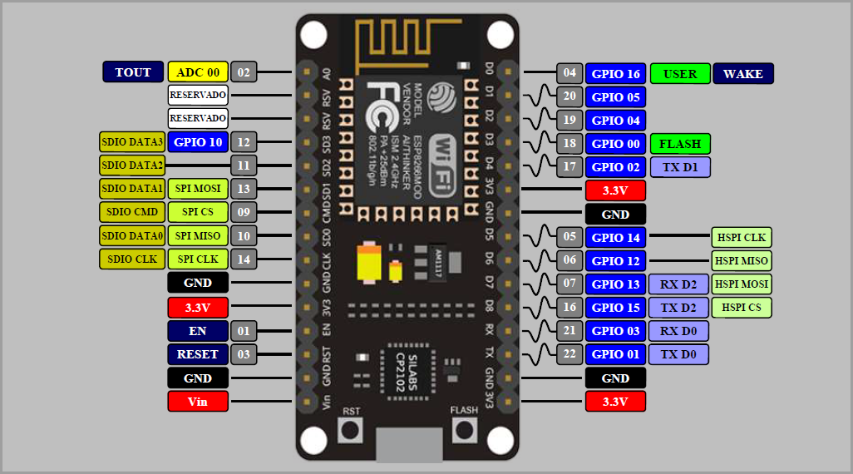
Parts of NodeMCU

Slide 5
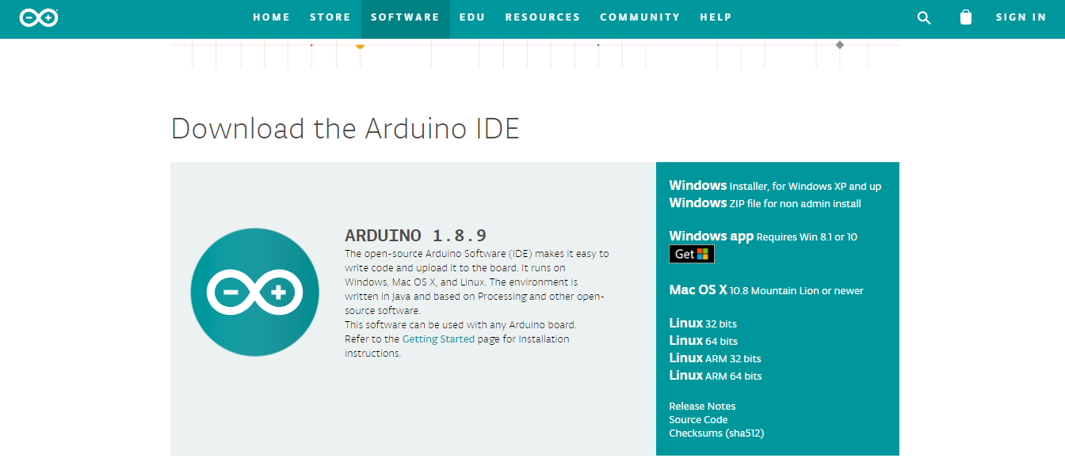
Download Arduino IDE Software from this link: https://www.arduino.cc/en/Main/Software

Slide 6
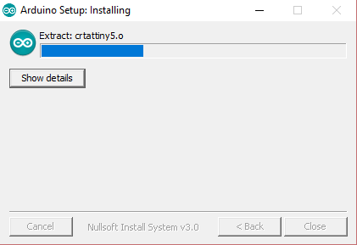
Install the Arduino IDE software

Slide 7
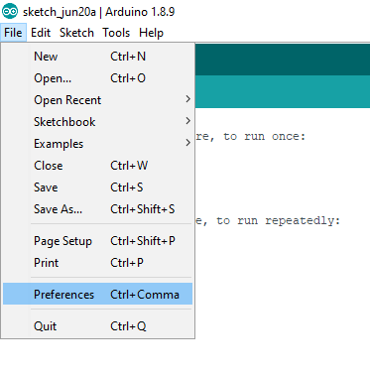
Open Arduino IDE and go to Preferences in File dropdown menu (Only for NodeMCU)

Slide 8
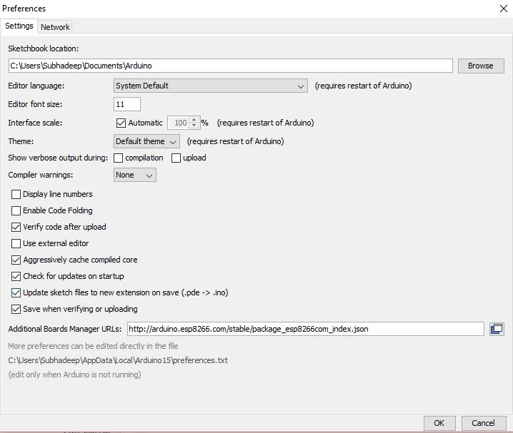
Add this path to the Additional Board Manager URLs: (Only for NodeMCU) https://arduino.esp8266.com/stable/package_esp8266com_index.json

Slide 9
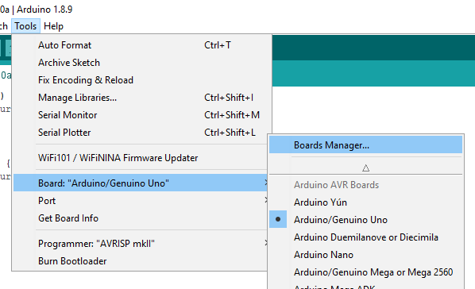
Go to Board Manager in the Tools dropdown menu. (Only for NodeMCU)

Slide 10
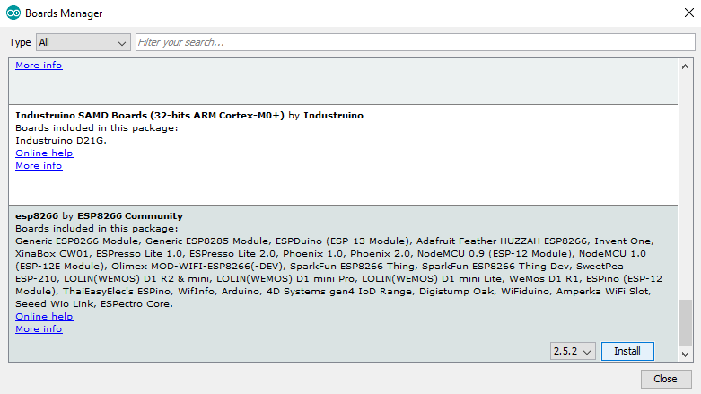
Install esp8266 by ESP8266 Community (Only for NodeMCU)

Slide 11
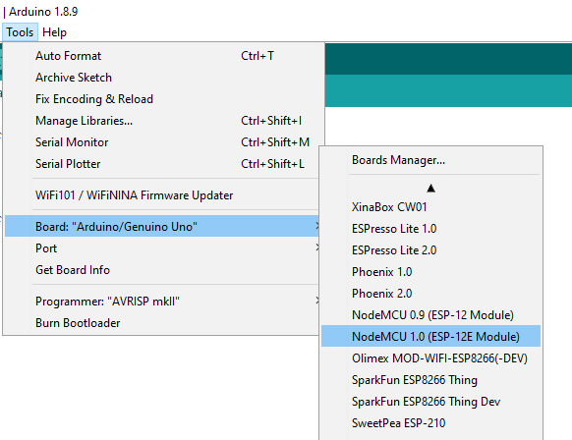
Select NodeMCU board after installation (Only for NodeMCU)

Slide 12
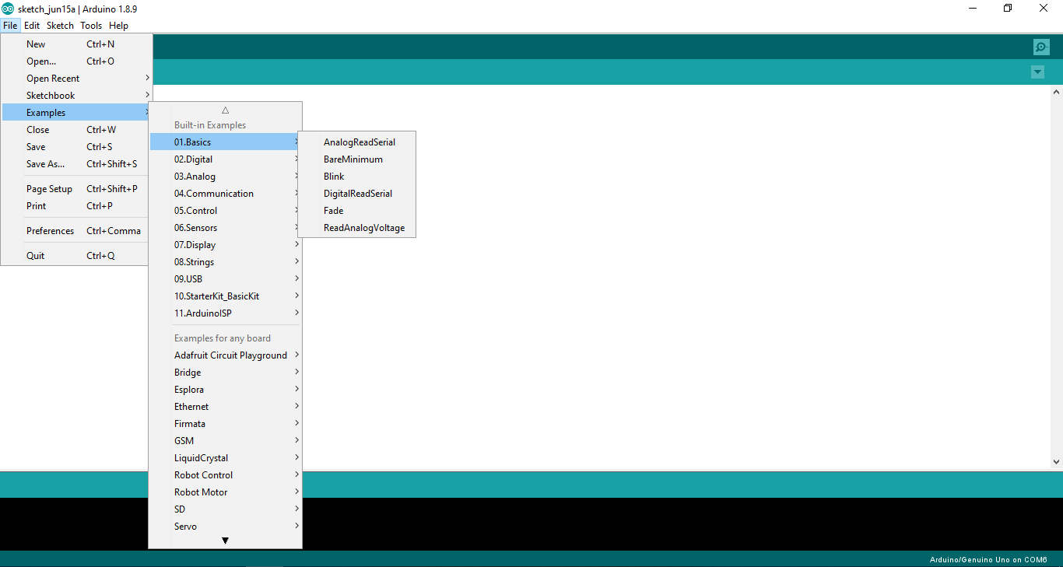
Open the software and play with existing examples

Slide 13
Connecting Sensors to the Arduino/ NodeMCU
2

Slide 14
Connecting sensors to Arduino/NodeMCU
All the VCC and GND pins should be connected to 5V/3.3V and GND pins of Arduino and NodeMCU respectively.
Most of the LDR modules, Soil Moisture modules, Water level modules, Rain Detection modules have VCC, GND, Analog Output and Digital Output pins.
The Analog Outputs can be given to any of the pins on the Analog side i.e. A0 to A5 and Digital Outputs from 2 to 13.
Values are read using analogRead(Pin no) and digitalRead(Pin no) from analog and digital sensors respectively. E.g: analogRead(A0), digitalRead(13)
digitalWrite(Pin no, LOW/HIGH) is used to pass LOW or HIGH signal to a digital pin which should be defined in the setup as shown here: pinMode(Pin_no, OUTPUT)

Slide 15
Connecting sensors to Arduino/NodeMCU
If there’s anything to print, Serial.begin(9600) is to be specified in the setup explicitly. Serial.print(“String”) is used to print in the Serial Monitor.
In HC05 module i.e. the Bluetooth one, the RX is connected to TX and TX is connected to RX of Arduino/NodeMCU and VCC & GND are connected to 5V/3.3V & GND respectively.
Never upload the code when RX and TX pins are connected to the HC05 module. Always connect only after the code is uploaded to the board.
For sensors like DHT11/DHT22 and BMP180/280, the corresponding libraries need to be downloaded which is shown in the consequent slides.
Ultrasonic sensors have an echo trigger mechanism. The trigger triggers the ultrasonic waves and the echo receives them. It calculates the distance based on the time in which the waves return just like how a bat uses ultrasonic waves to calculate the distance.

Slide 16
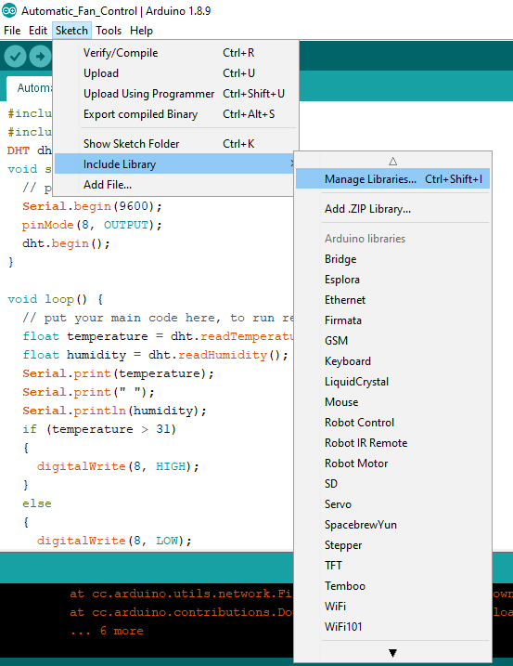
Installing libraries for DHT
Go to Manage Libraries:

Slide 17
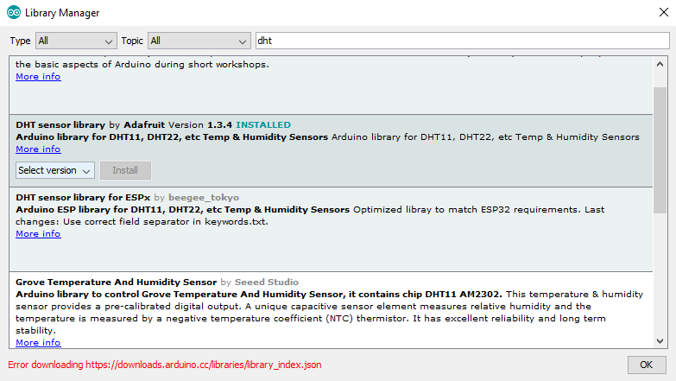
Installing libraries for DHT
Go to Manage Libraries:

Slide 18
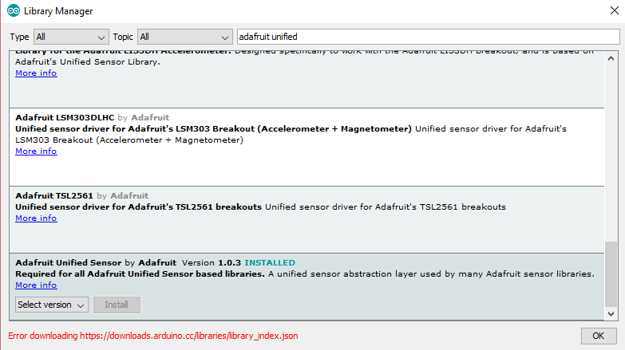
Installing libraries for DHT
Install Adafruit Unified Sensor:

Slide 19
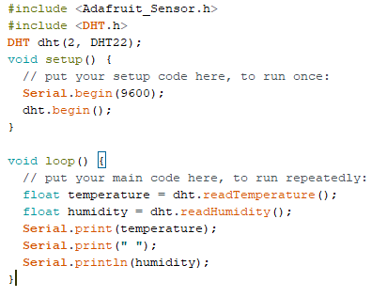
DHT code to read from pin 2 of Arduino for DHT22 and send output values based on temperature(for NodeMCU pin no is written followed by D):

Slide 20
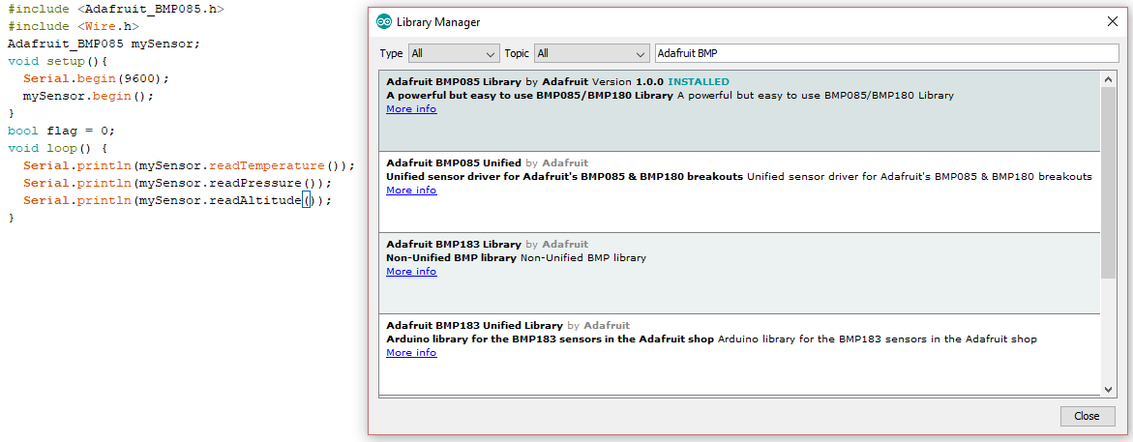
For BMP180 to Arduino connection:
Install the following library and run the code. The BMP should be connected to 3.3V, GND, SDA and SCL pins of the Arduino board. It works for even later version of BMP like BMP180.

Slide 21
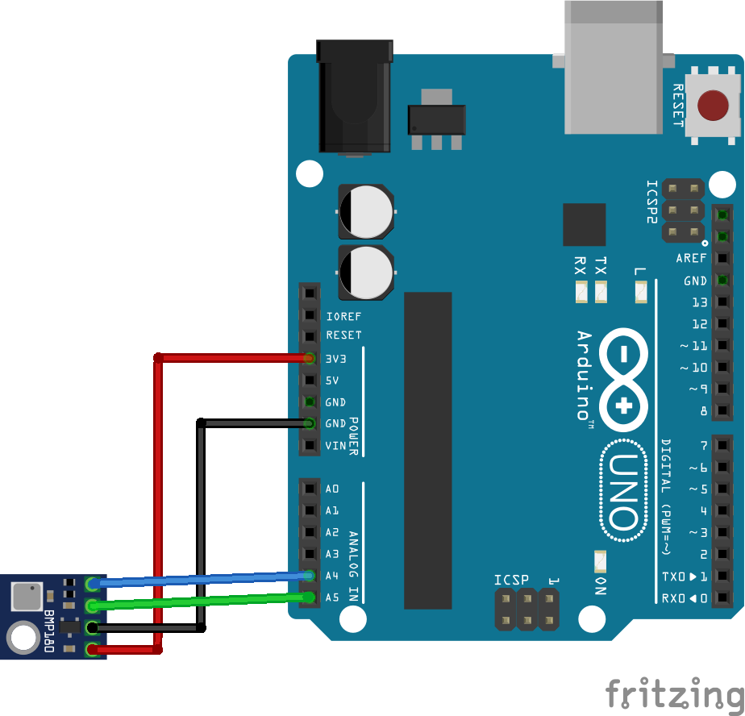
BMP180 uses I2C kind of communication. So, the connection diagram ought to be as shown below:

Slide 22
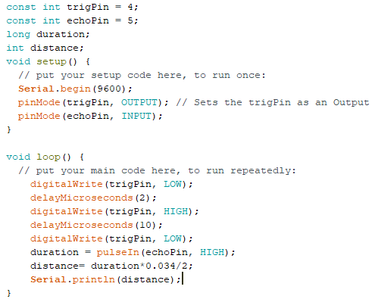
The code for computing distance using Ultrasonic sensor is given below. The trigPin and echoPin can be given to any Digital pins present on the board.

Slide 23
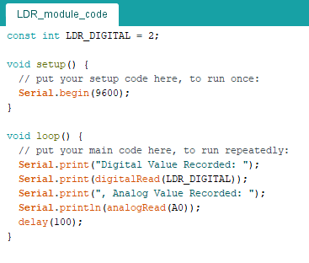
For all other kinds of sensors this code should work i.e. for the ones having both analog and digital output.

Slide 24
Connecting LED lights for Output
3

Slide 25
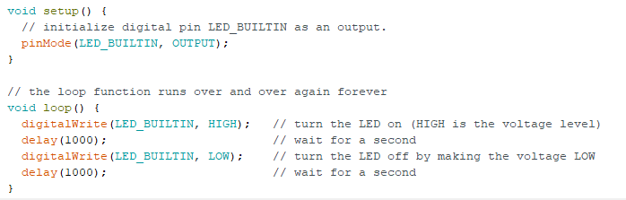
Connecting LEDs to Arduino
Connect the positive end of the LED to the digital pin to which the output is supplied and negative end of it is connected to one end of a resistor.
The other end of the resistor is connected to the GND of the Arduino.
The output pin needs to be initialized in the setup.
A simple blink example for an LED is given here:

Slide 26
Powering high voltage devices like motors using L293D ICs
4

Slide 27
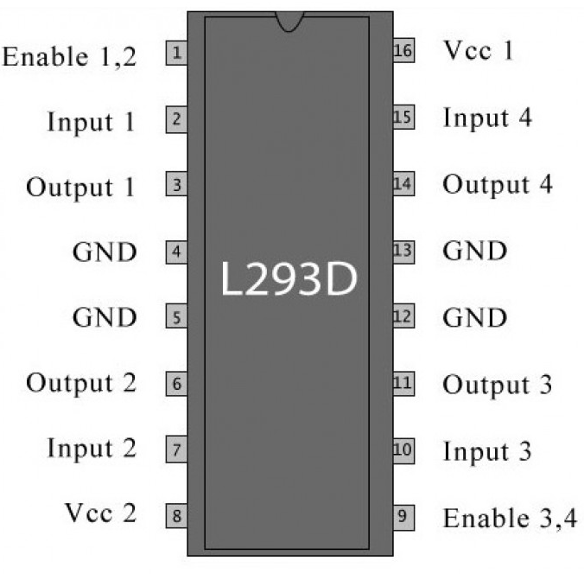
Connecting High Voltage devices like motors to Arduino through L293D
DC motors should never be directly connected to Arduino else it can result in damage of the board.
L293D acts as a switch to power motors and water pumps through an external power source like battery.
The GND of the power source i.e. battery and Arduino are connected and provided to each of the GND pins of the IC i.e. pins 4, 5, 12 and 13.
The VCC1 and VCC2 need power from the battery source. So, they are connected to the positive terminal of the power source i.e. battery.
The Enable 1, 2 should be given 5V from Arduino so that inputs and outputs 1 and 2 can be used.

Slide 28
Connecting High Voltage devices like motors to Arduino through L293D
The inputs and outputs 3 and 4 can be left as we are going to use a single motor while this IC can support 2 motors. Even the Enable 3, 4 can be left or provided logic LOW i.e. GND from Arduino.
The input 1 i.e. pin 2 can be connected to the digital pin from which output is received and the input 2 i.e. pin 7 can be given GND from Arduino
The outputs 1 and 2 i.e. pins 3 and 6 can be connected to the power.
Only if the input 1 is high, power is passed to the output 1 which makes the motor run.
In this way DC motors and high voltage of around 9 to 12 V appliances can be controlled using L293D as a switch.

Slide 29
MIT App Inventor 2 tutorial
5

Slide 30
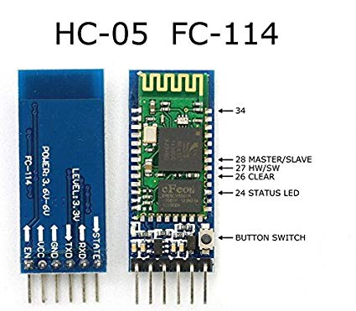
Connecting HC05 i.e. Bluetooth Module to Arduino Uno
HC05 module transmits whatever data is printed on the serial monitor.
The VCC, GND pins are connected to the VCC, GND pins of the Arduino board respectively.
The RX, TX pins of the Bluetooth module are connected to the TX, RX pins of the Arduino respectively which are the serial pins.
The app for receiving the values sent through Bluetooth is built using MIT App Inventor 2.
Apps for IoT can easily be built through MIT App Inventor2.
Always connect RX and TX to Arduino only after uploading the code. The password of HC-05 for first time connection is either 0000 or 1234.

Slide 31
Write a simple Arduino code to read analog and digital values and print it in Serial Monitor:

Slide 32
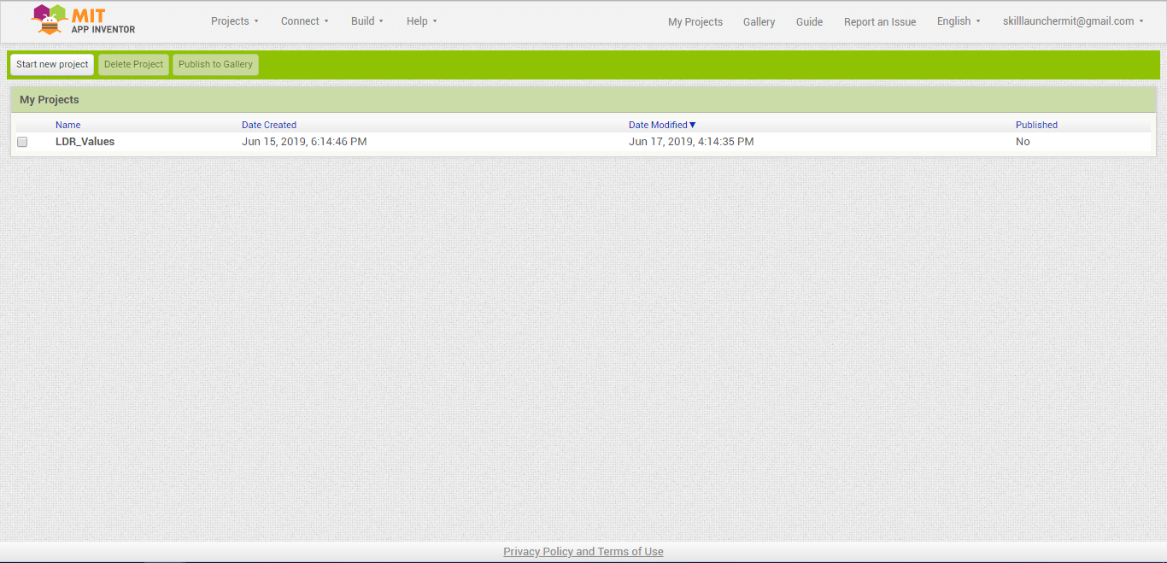
Create a project in the home screen after logging in with your Gmail account:

Slide 33
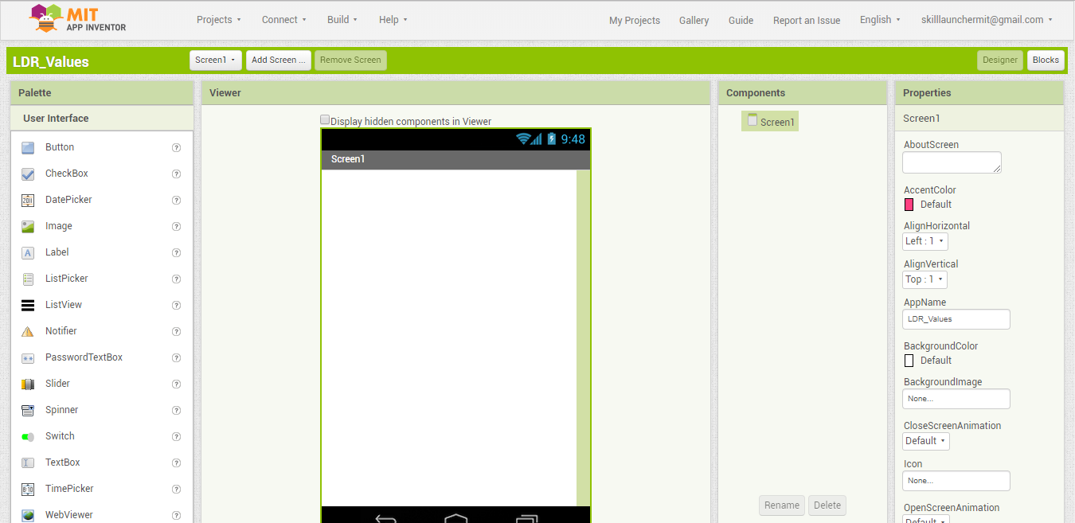
Enter the project:

Slide 34
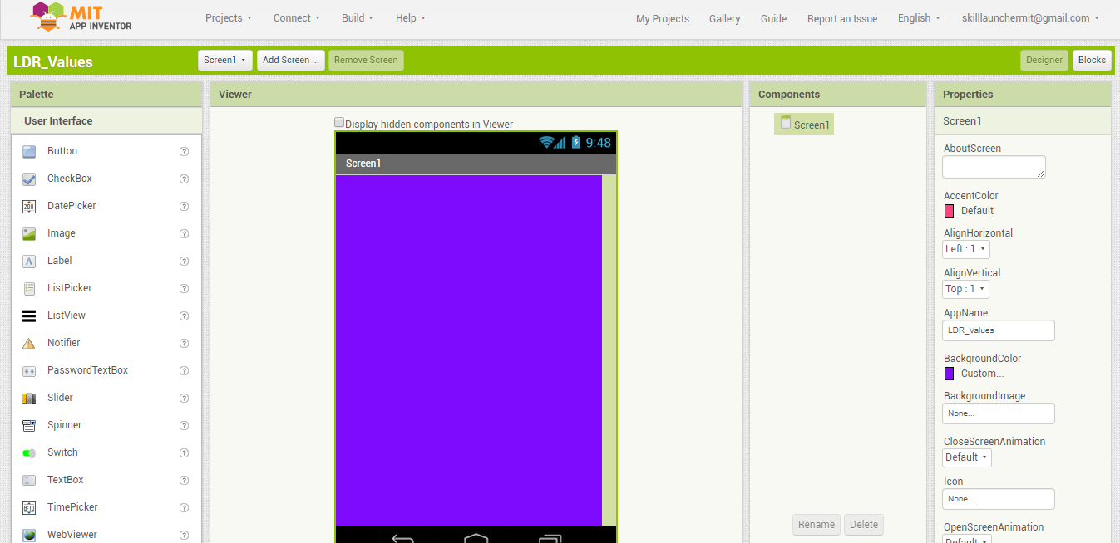
Change the background for better looks:

Slide 35
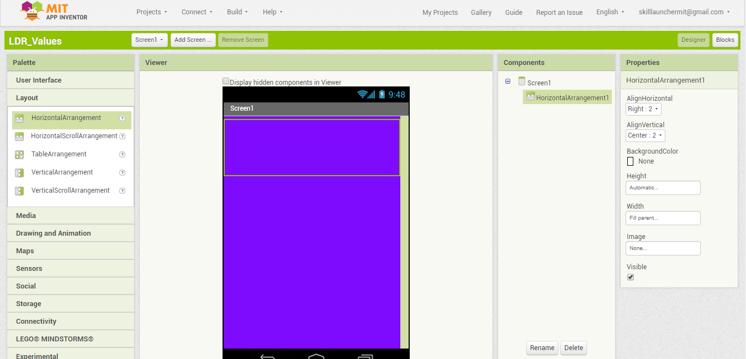
Add a horizontal component:

Slide 36
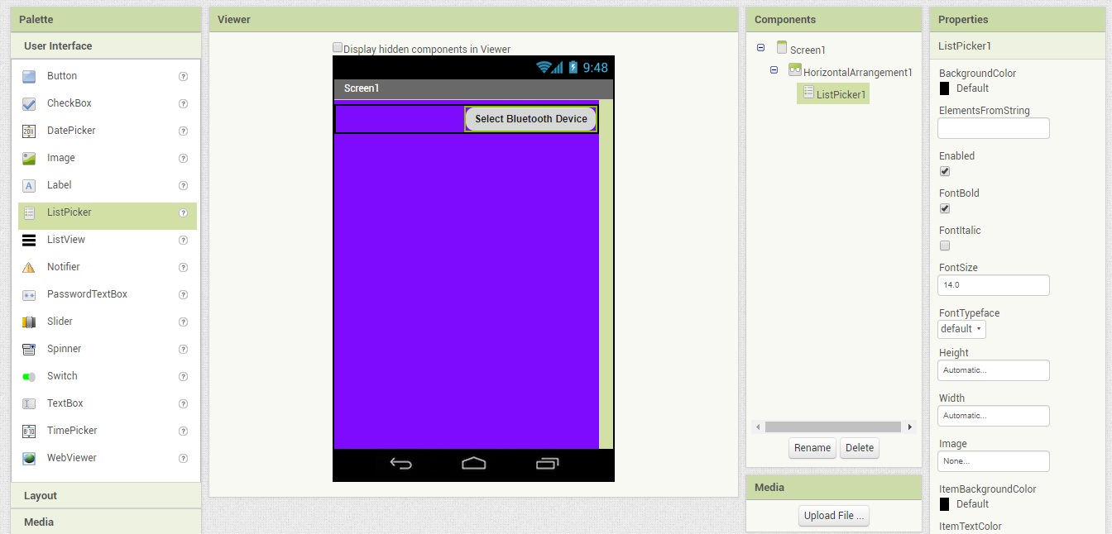
Add a listpicker to select your Bluetooth device from the list of devices

Slide 37
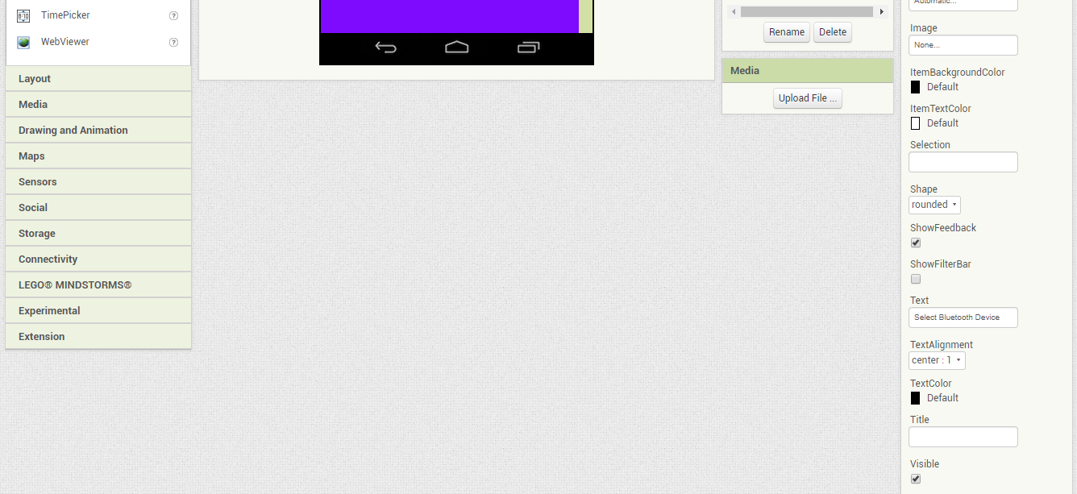
And change some properties for styling:

Slide 38
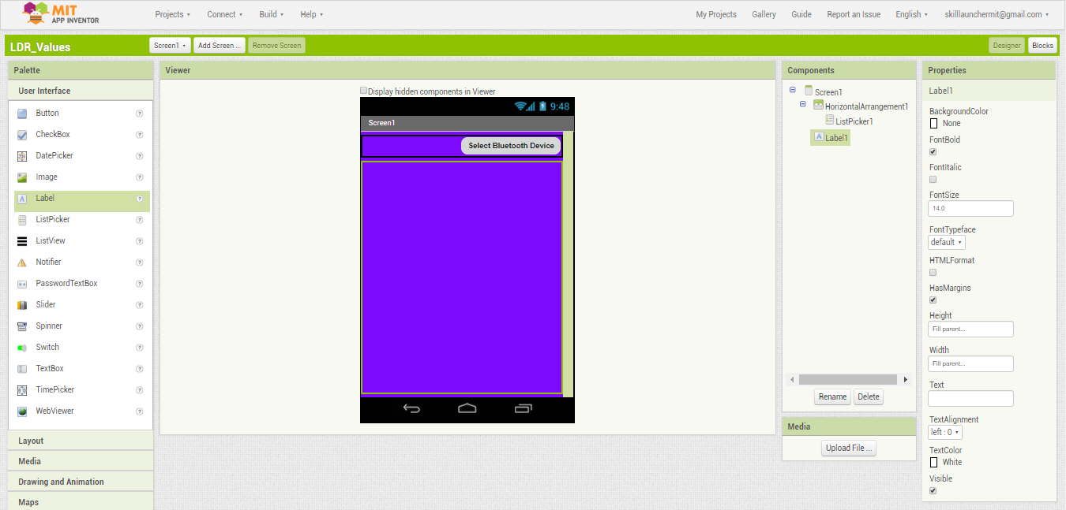
Add a label for displaying text received:

Slide 39
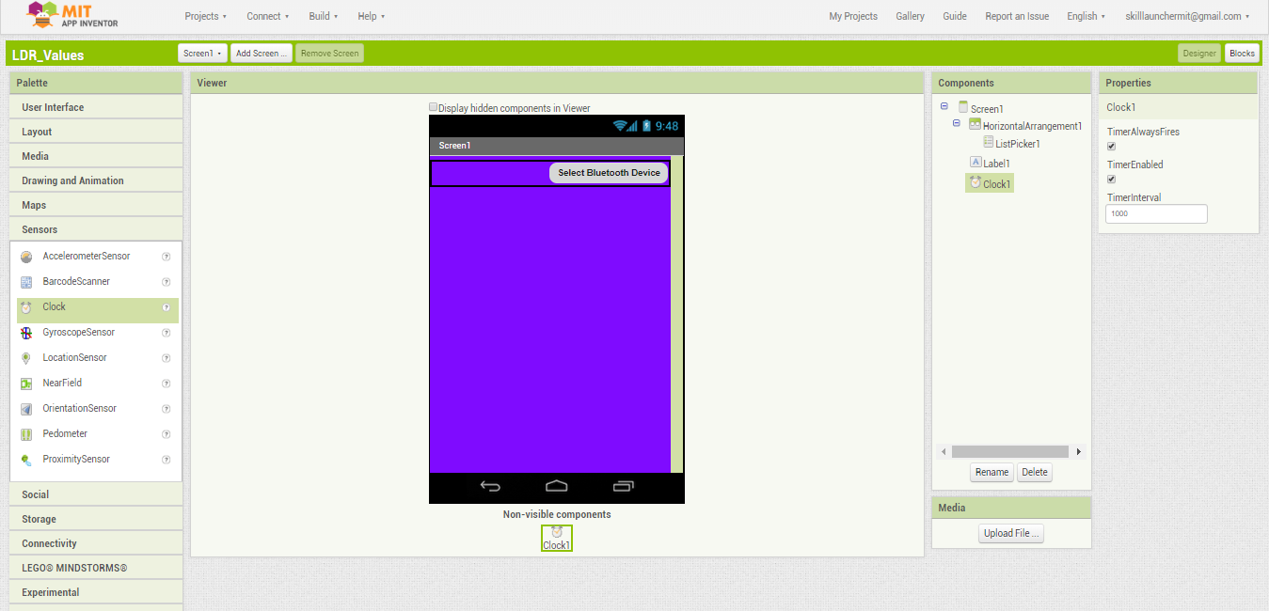
Adding a clock for timely updates:

Slide 40
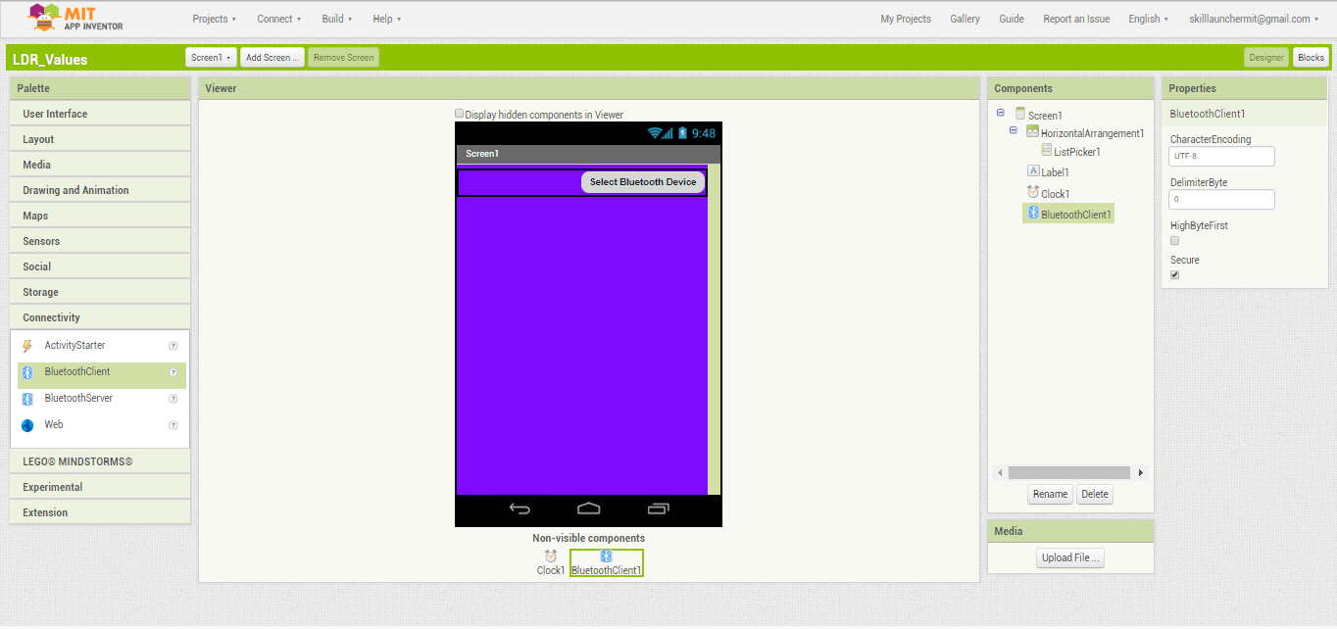
Adding a Bluetooth Client for receiving values:

Slide 41
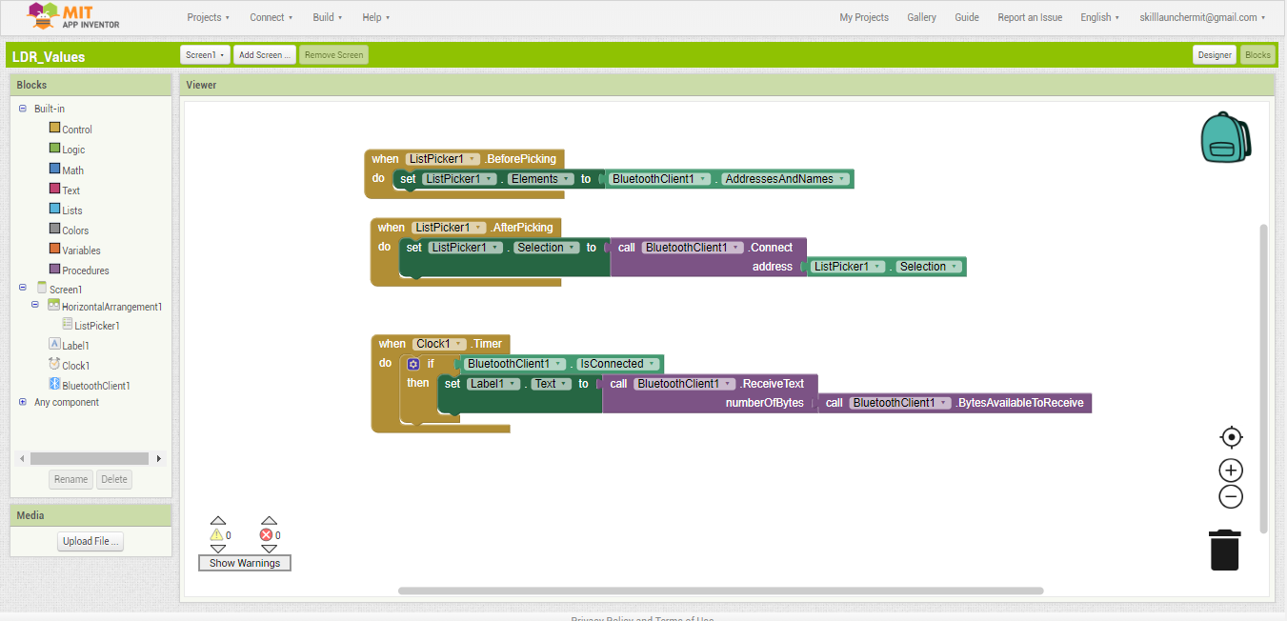
Adding logic for selecting device and receiving values:

Slide 42
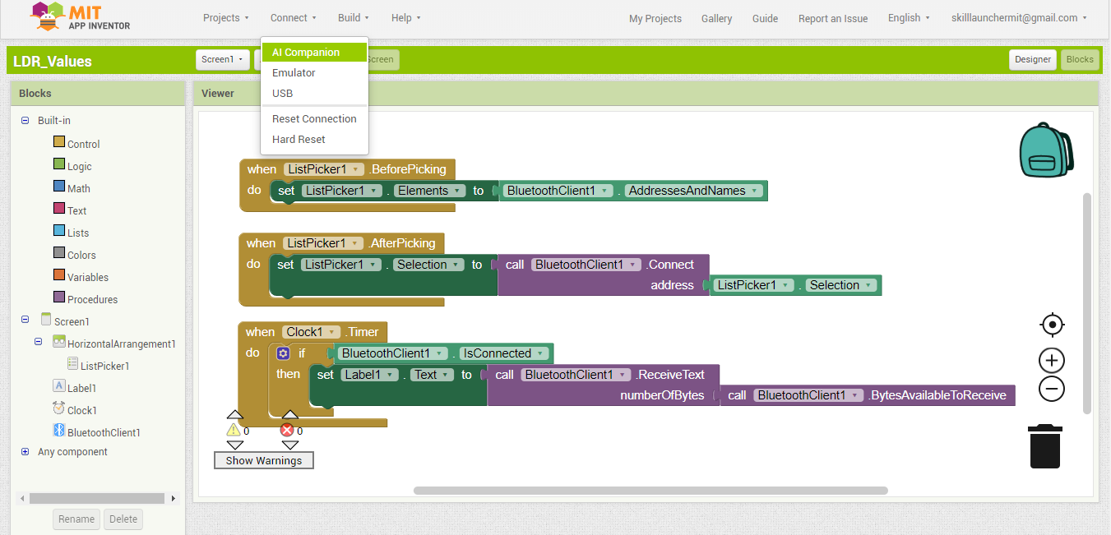
Building the app and visualizing the app using MIT AI2 Companion App available in Play Store:

Slide 43
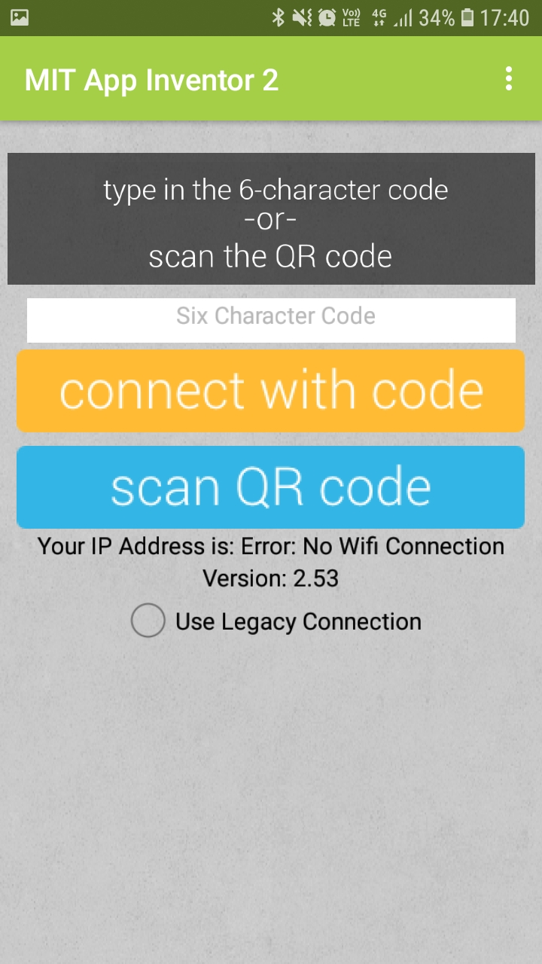
Connecting app built to MIT AI2 Companion app installed on Android phone:

Slide 44
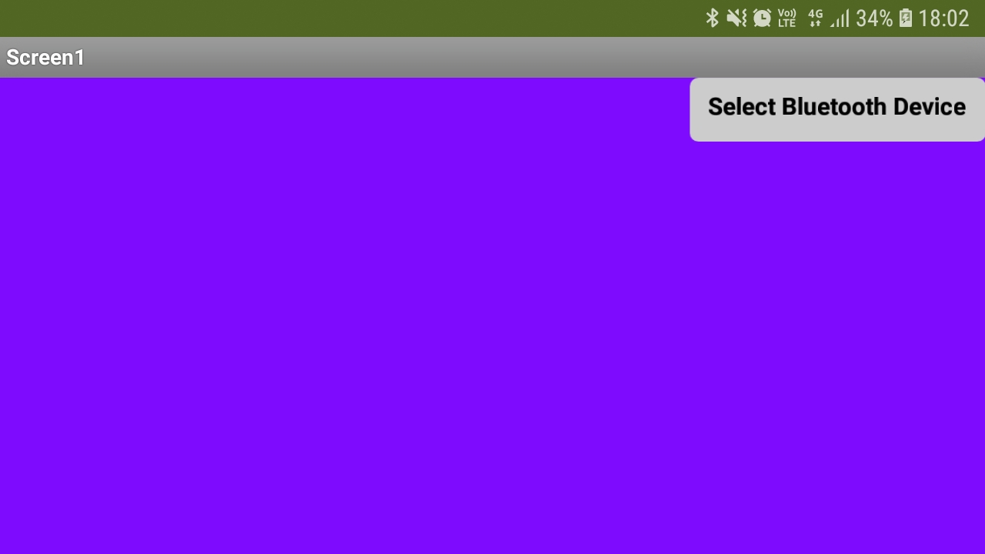
Testing in MIT AI2 Companion app installed on Android phone:

Slide 45
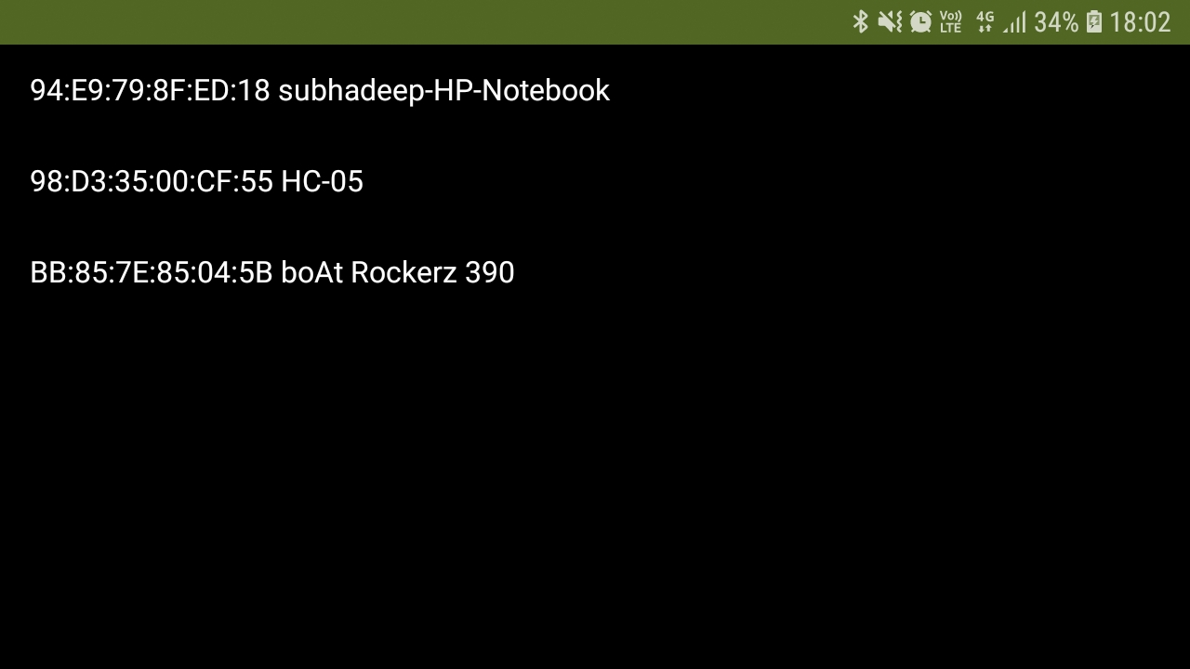
Clicking on Select Bluetooth Device gives list of devices. Select HC-05:

Slide 46
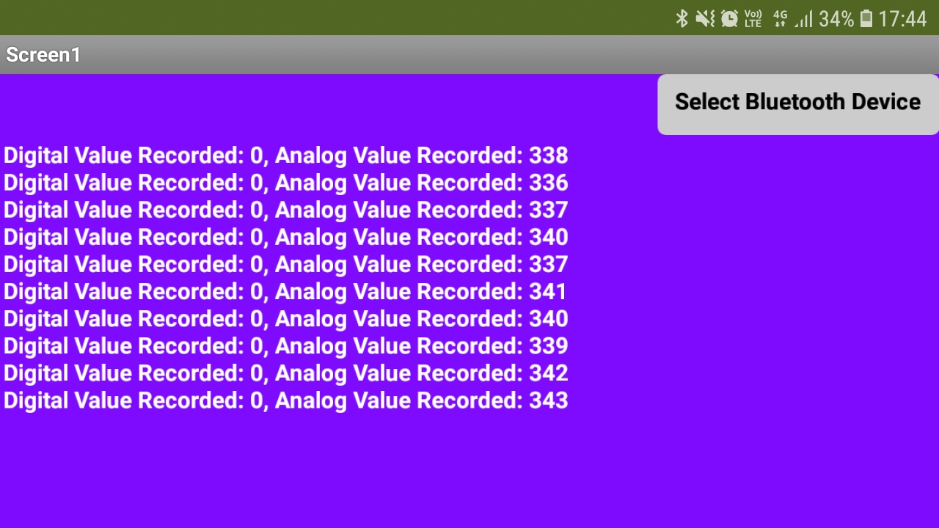
Checking Values Received:

Slide 47
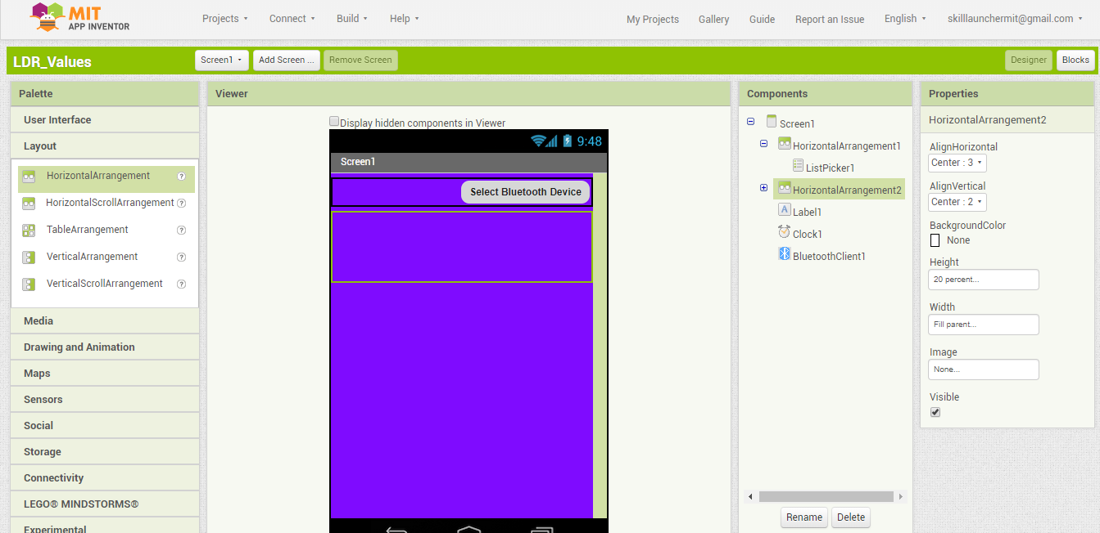
Add another horizontal arrangement layout:

Slide 48
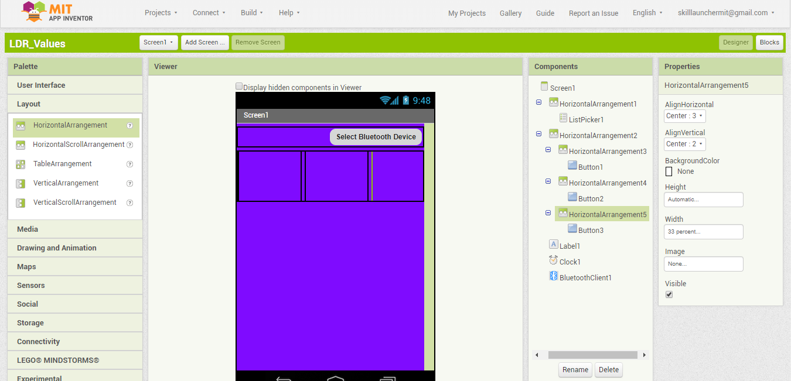
Adding horizontal components in the new horizontal component:

Slide 49
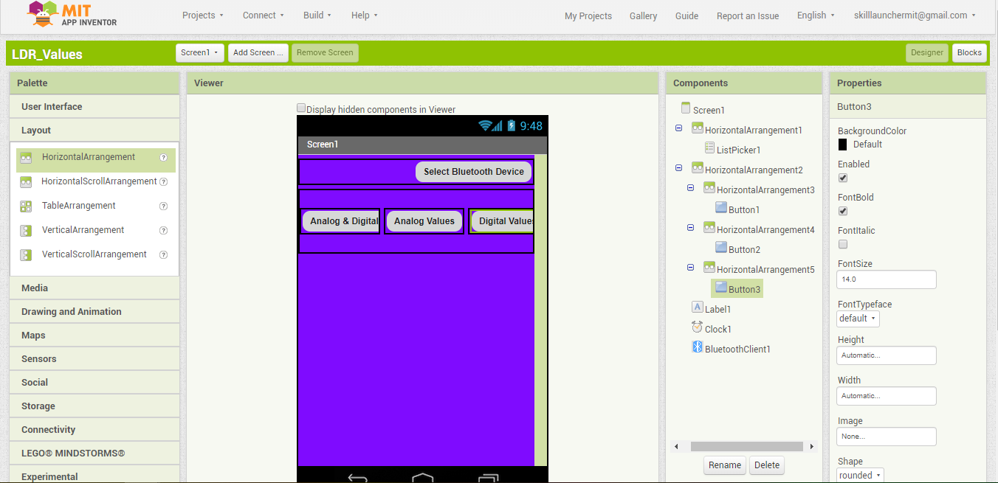
Adding buttons in the horizontal components:

Slide 50
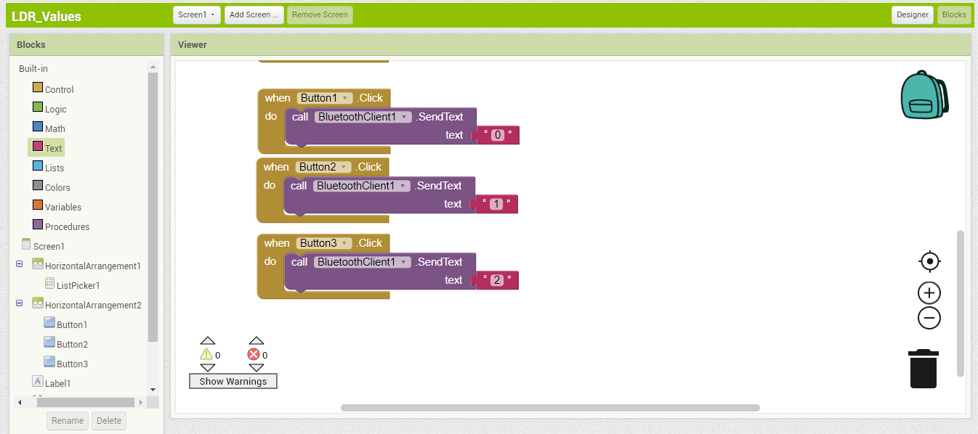
Adding the following logic blocks:

Slide 51
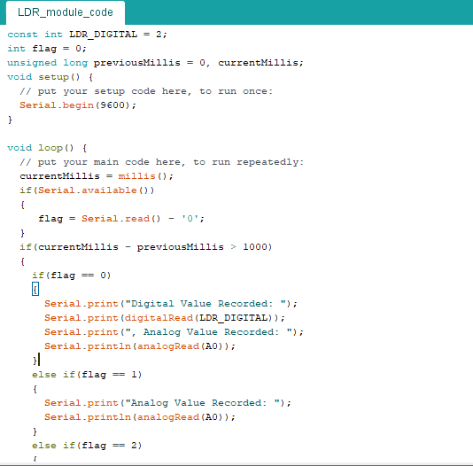
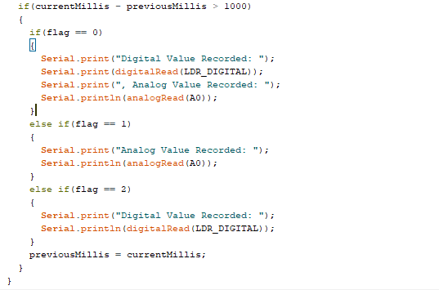
Change the Arduino Code as follows to receive signals from mobile:

Slide 52
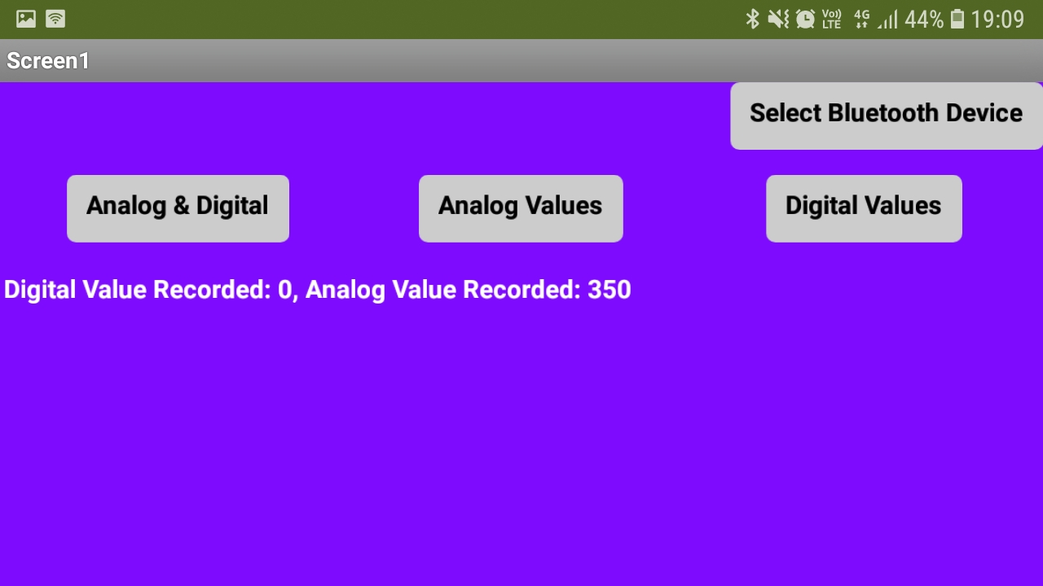
Clicking on the first button gives both analog and digital values:

Slide 53
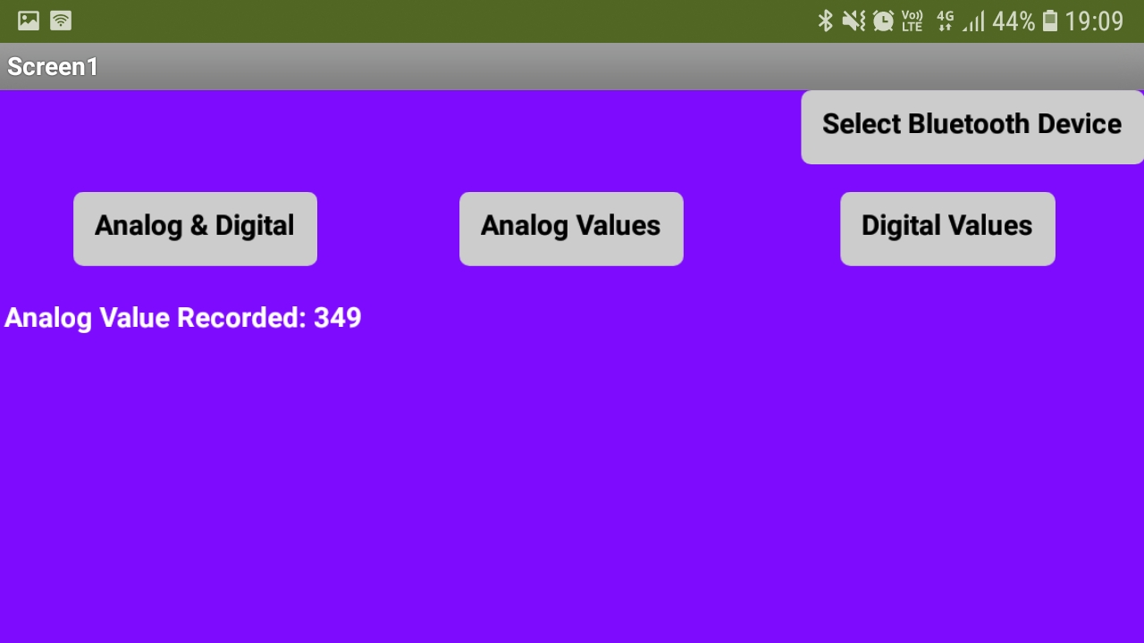
Clicking on the second button gives analog values:

Slide 54
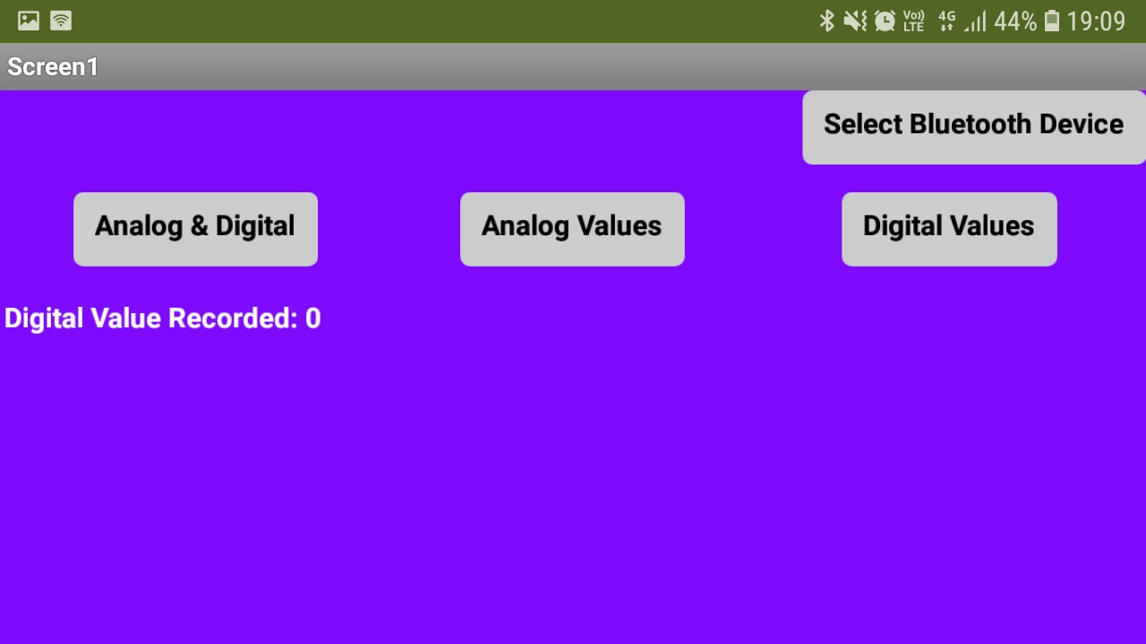
Clicking on the third button gives digital values:

Slide 55
THANKS!
Any questions?
You can find me at
subhadeep.d16@iiits.in

